Slide 1
Annotation pipelines in practice
Ground truth for AI evals with Prodigy

Slide 2
Agenda
Introduction
Annotation vs Evaluation
Annotation project design
Prodigy as an annotation tool
Annotation tasks: classification, NER, IE, summarization, document partitioning, RAG?
Prodigy demo with code for each task
Using Prodigy for model output investigation / insights
Q & A

Slide 3
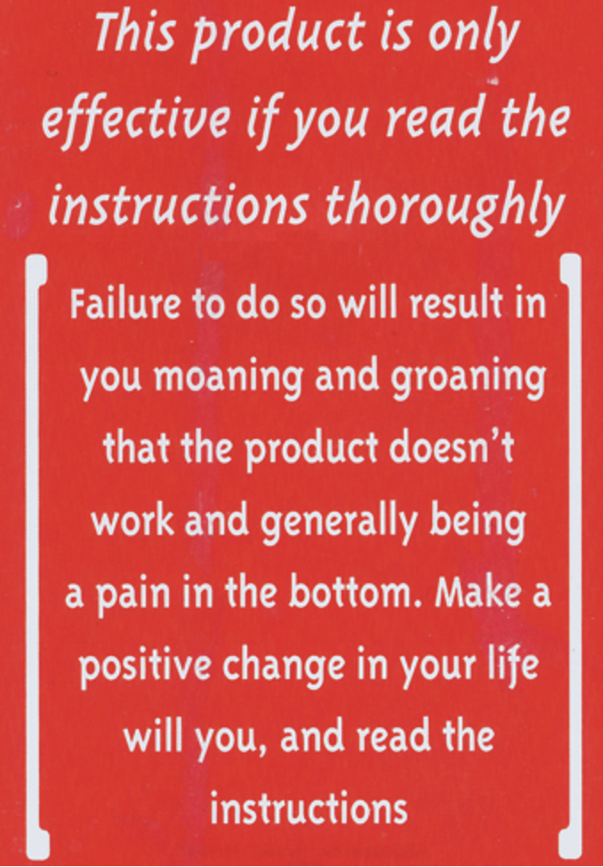
RTFM
A Unique RTFM Message
This notice came from the 2012 issue of Maximum PC magazine's guide to building your own PC.
Source: https://www.pcmag.com/encyclopedia/term/rtfm /
“
RTFM is an acronym and internet slang for the expression "Read the f***ing manual"– typically used to reply to a basic question where the answer is easily found in the documentation, user guide, owner's manual, man page, online help, internet forum, software documentation or FAQ.
– wikipedia.org –
Prodigy has an excellent documentation, please take the full advantage of it:
https://prodi.gy/docs

Slide 4
Expert-in-the-loop Treadmill
Non-scalable: Each model update demands renewed SME review time
No knowledge accumulation: Expert feedback is not captured as structured data, so the process never compounds.
High cost: SMEs are expensive
Delayed iteration: Models can’t be retrained or deployed quickly because review cycles block releases.
Opaque traceability: Without a persistent dataset, it’s impossible to reproduce prior evaluation outcomes.
Burnout risk: Experts repeat the same reviews indefinitely
Evaluation
Model Developer
SME
Improvements
Outputs
Model

Slide 5

Expert-in-the-loop Treadmill

Slide 6
Continuous Evaluation Loop
Turning expert effort into persistent data assets
Evaluation
Model Developer
SME
Annotation
Ground
Truth
Model improvements
Only when needed
Outputs
Model

Slide 7
Annotation Project Design
Some design considerations:
Labeling schema: entities, spans, text classification, binary choice, etc
Granularity: full document vs fragment vs sentence
Single-step vs multi-step workflows: some tasks need two phases (identify spans -> categorize), while others can be single-pass.
Pre-labeling strategy: using model-assisted labeling saves time but risks anchoring bias.
Adjudication: must define how conflicts are resolved — consensus, majority vote, or expert adjudicator.
Annotation Project Design
Initial Annotation Round
Review Disagreements
SME
Annotation Guidelines
SME
SME + Model Developer
Dataset
Model Developer

Slide 8
Annotation Workflow
Some design considerations:
Model developer as annotator: quite unconventional, but highly effective practice
Model outputs: if model is mature, can help with discovering annotation errors. Also, may be used for pre-labeling.
Double-review: we observed ~7-8% disagreement rate between annotators. First, SME and Model Developer review disagreements separately, and then review their adjudication differences together.
Annotation Round
Review 1
Review 2
Ready
SME
Annotation Guidelines
SME
SME Adjudicator
SME + Model Developer
Gold Standard
Dataset
Model Developer
Model Developer
Dataset
Model

Slide 9
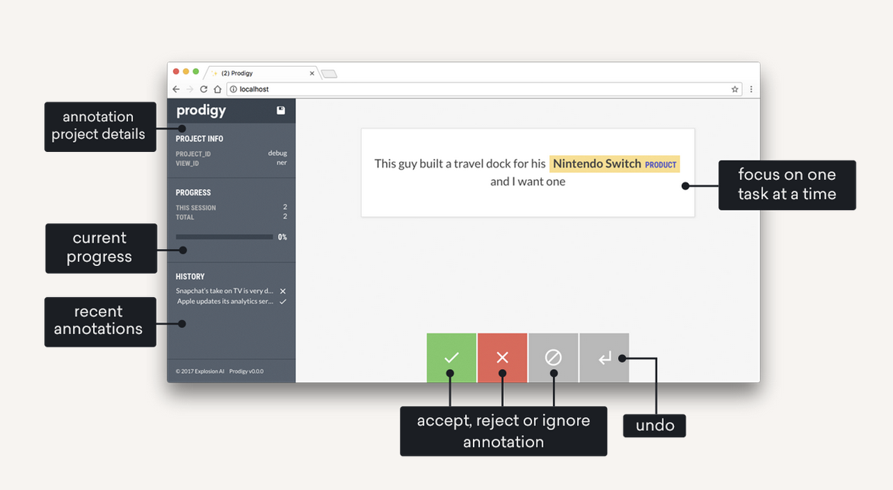
Prodigy: a modern annotation tool from creators of spaCy
Runs locally: no privacy restrictions
Built for customization: allows to define fully custom data feeds and interfaces
Out-of-the-box interfaces: multiple annotation interfaces are available (e.g. NER, Entity Relations, Classification)
Clean, distraction-free interface: allows to focus on one task at a time
Stores data in DB: supports Sqlite, PostgresQL and MySQL databases

Slide 10
Resources
Prodigy website: https://prodi.gy/
Documentation: https://prodi.gy/docs
Live Demo: https://demo.prodi.gy
Blog: https://explosion.ai/_/topic/llms

